Slide 1
Power BI DAX Class
REMOVE THIS COMMENT BEFORE TEACHING
Enter your name and company
Hobbs
Valorem Reply

Slide 2
Course aim
Understand the impact Modeling has on DAX
Understand the impact Vertipaq Compression has on DAX
Introduce Data Analysis Expressions (DAX)
Learn the calculation basics
Define common business calculations
BETA version

Slide 3
Prerequisites
Experience modeling and writing basic calculations
Experience working in Power BI Desktop
A computer running Windows 10 or higher
Power BI Desktop installed and up-to-date
Course Lab Manuals, available on GitHub
BETA version

Slide 4
Course modules
01:Underlying Constructs: Data Models & Vertipaq Compression
02: Write DAX Formulas
03: Define Calculated Tables and Columns
04: Define Measures
05: Use DAX Iterator Functions
06: Modify Filter Context
07: Use DAX Time Intelligence Functions
BETA version

Slide 5

Labs
Scenario
The labs are based on the sales activities of the fictitious Adventure Works company
The Adventure Works company:
Represents a bicycle manufacturer that sells bicycles and accessories to global markets
Accumulates operational data in an Azure SQL Database
Needs to explore and discover deeper insight from their data
In the labs, as their data modeler author, you will enhance an existing model with calculations

Slide 6
Agenda (times are approximate and will be fluid with the class)
Morning
10 Minutes | Introductions
20 Minutes | Data Modeling
30 Minutes | Vertipaq Compression
10 Minutes | Analytics Queries & Visuals
10 Minutes | Q&A
10 Minutes | Break
30 Minutes | Calculation Types
40 Minutes | DAX Syntax & Theory
10 Minutes | Q&A
10 Minutes | Break
15 Minutes | Lab 02: Basic Measures and Variables
10 Minutes | Q&A and Review
20 Minutes | Lab 03: Calculated Tables, Columns, and Relationships
10 Minutes | Q&A and Review
10 Minutes | Lab 04
10 Minutes | Q&A and Review
15 Minutes | Open Q&A
Notes:
Key message: in this workshop we will cover the breath of Power BI capabilities.
After analyzing and visualizing the dataset provided in the workshop, you will use these skills to get started on your own data.

Slide 7
Resources
Use DAX in Power BI Desktop
This Microsoft learning path introduces Data Analysis Expressions (DAX) and provides you with foundational skills required to enhance data models with calculations
https://docs.microsoft.com/learn/paths/dax-power-bi/
DAX videos
https://docs.microsoft.com/dax/dax-learn-videos
Data Analysis Expressions (DAX) Reference
https://docs.microsoft.com/dax/
Learn path for individual study:
Use DAX in Power BI Desktop - Learn | Microsoft Docs

Slide 8
Power BI DAX in a Day
Module 01
Underlying Constructs

Slide 9
Module outline
01: Introduce Data Models
Data model fundamentals
Star schema design
Vertipaq Compression
Define analytic query
Configure report visuals
BETA version
Notes:
This module introduces the basics of data models. The topics covered in this module are essential to support the DAX theory covered in later modules.

Slide 10
Data model fundamentals
Tabular model
A Data model is a query-able data resource optimized for analytics
Microsoft data models can be queried using DAX or MDX
A Tabular model comprises one or more tables
It possibly defines relationships, hierarchies, hierarchy levels, and calculations.
All Power BI models are tabular
BETA version

Slide 11
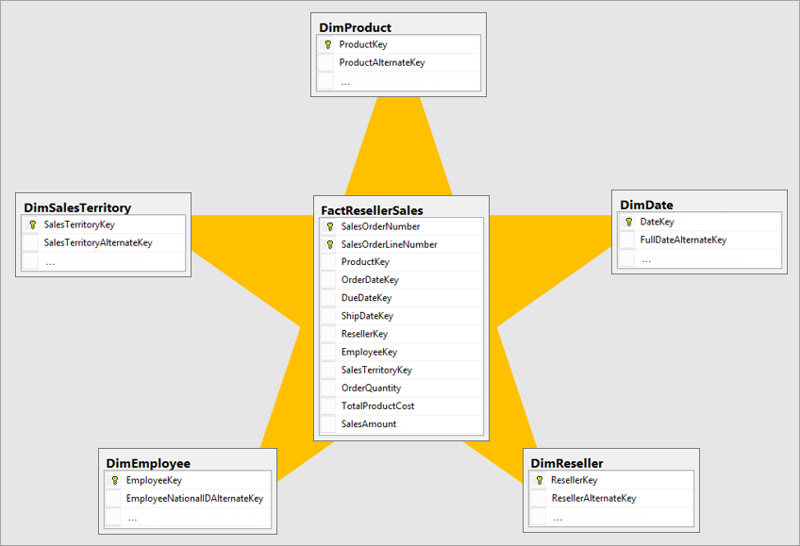
Star schema design
Fact tables
Dimension tables
For a detailed explanation of star schema, read the Understand star schema and the importance for Power BI article
BETA version

Slide 12
Star schema design
Fact tables
A Fact table stores an accumulation of rows
It records a specific business activity, for example:
Sales transactions
Stock movements
Daily currency exchange rates
BETA version
Notes:
The role of a fact table is to store an accumulation of rows that represent observations or events that record a specific business activity. For example, events that are stored in a sales fact table could be sales orders and the order lines.
You could also use a fact table to record stock movements, stock balances, or daily currency exchange rates.
Generally, fact tables contain numerous rows. As time passes, fact table rows accumulate.
In analytic queries (which will be defined later in this module), fact table data is summarized to produce values like sales and quantity.
You can have more than 1 Fact table in a model

Slide 13
Star schema design
Dimension tables
A Dimension table describes a business entity
It is designed to filter and group related fact table data, for example:
Date
Product
Geography
People (employees or customers)
Each dimension table must have a unique column (key) so a relationship can be created to the fact tables
BETA version
Notes:
Dimension tables describe your business entities, which commonly represent people, places, products, or concepts.
A date dimension table, which contains one row for each date, is a common example of a concept dimension table.
The columns in dimension tables allow filtering and grouping of fact table data.
Each dimension table must have a unique column, which is referred to as its key column.
A unique column doesn't contain duplicate values and it should never have missing values.
In a product dimension table, the column could be named ProductKey or ProductID.
Likely, additional columns will store descriptive values, like the product name, subcategory, category, color, and so on.
In analytic queries, these columns are used to filter and group data

Slide 14
Star schema design
Compare table types
 | Dimension table | Fact table
Model purpose | Stores business entities | Stores events or observations
Table structure | Includes a key column and descriptive columns for filtering and grouping | Includes dimension key columns and numeric measure columns that can be summarized
Data volume | Typically, contains fewer rows (relative to fact tables) | Can contain numerous rows
Query purpose | To filter and group | To summarize
Dimension tables:
Store business entities
Include a key column and descriptive columns for filtering and grouping
Typically, contain fewer rows (relative to fact tables)
Are used by visuals to filter and group
Fact tables:
Store events or observations
Include dimension key columns and numeric measure columns that can be summarized
Can contain numerous rows
Are used by visuals to summarize
BETA version
Notes:
The following table to revise and compare the characteristics of fact and dimension tables.

Slide 15
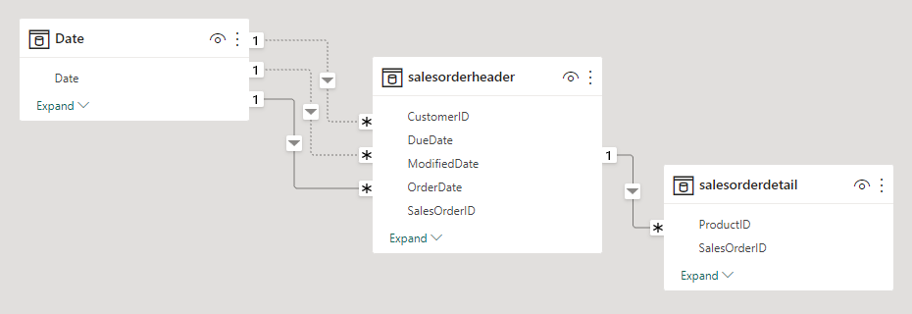
Relational Paths
Star or Snowflake Schemas

Slide 16
Vertipaq Analyzer
Columnar Compression Engine
Antithetical to Excel
Encoding based on column data

Slide 17
Comparison to Excel
SaleID | Amount | State | ProductCategory | Store
1 | 4000 | Missouri | High Powered Gaming Personal Computer | StuffMart
2 | 3500 | Arkansas | Mid Powered Business Laptop | StuffMart
3 | 3700 | Kansas | Mid Powered Business Laptop | StuffMart
4 | 4300 | Illinois | Low Powered 2-in-1 Laptop | StuffMart
5 | 4150 | Illinois | Tablet | StuffMart
6 | 4650 | Arkansas | High Powered Gaming Personal Computer | StuffMart
7 | 3350 | Arkansas | Low Powered 2-in-1 Laptop | StuffMart
8 | 2800 | Kansas | Tablet | StuffMart
9 | 4900 | Missouri | High Powered Gaming Personal Computer | StuffMart
10 | 4200 | Illinois | Mid Powered Business Laptop | StuffMart

Slide 18
Conversion to Columns
SaleID
1
2
3
4
5
6
7
8
9
10
Amount
4000
3500
3700
4300
4150
4650
3350
2800
4900
4200
State
Missouri
Arkansas
Kansas
Illinois
Illinois
Arkansas
Arkansas
Kansas
Missouri
Illinois
ProductCategory
High Powered Gaming Personal Computer
Mid Powered Business Laptop
Mid Powered Business Laptop
Low Powered 2-in-1 Laptop
Tablet
High Powered Gaming Personal Computer
Low Powered 2-in-1 Laptop
Tablet
High Powered Gaming Personal Computer
Mid Powered Business Laptop
Store
StuffMart
StuffMart
StuffMart
StuffMart
StuffMart
StuffMart
StuffMart
StuffMart
StuffMart
StuffMart

Slide 19
Encoding Example 1: Value
Amount
4000
3500
3700
4300
4150
4650
3350
2800
4900
4200
Amount
120
70
90
150
135
185
55
0
210
140
MAX VALUE = 4,900
MIN VALUE = 2,800
DELTA = 2,100
AMOUNT FORMULA = X / 10 – (2800/10)

Slide 20
Encoding Example 2: Hash + Dictionary
State
Missouri
Arkansas
Kansas
Illinois
Illinois
Arkansas
Arkansas
Kansas
Missouri
Illinois
State
0
1
2
3
3
1
1
2
0
3
State | Index
Missouri | 0
Arkansas | 1
Kansas | 2
Illinois | 3
Create a Dictionary
Reference Dictionary

Slide 21
Encoding Example 2: + Run Length
State | Index
Missouri | 0
Arkansas | 1
Kansas | 2
Illinois | 3
State
0
1
2
3
3
1
1
2
0
3
Index | Start | Count
0 | 1 | 1
1 | 2 | 1
2 | 3 | 1
3 | 4 | 2
1 | 6 | 2
2 | 1 | 1
0 | 1 | 1
3 | 1 | 1
Determine ordered Run Length

Slide 22
Encoding Example 3: H + D + RL Comparison
Efficient
Inefficient
Store
StuffMart
StuffMart
StuffMart
StuffMart
StuffMart
StuffMart
StuffMart
StuffMart
StuffMart
StuffMart
Store | Index
StuffMart | 0
SaleID
1
2
3
4
5
6
7
8
9
10
SaleID | Index
1 | 0
2 | 1
3 | 2
4 | 3
5 | 4
6 | 5
7 | 6
8 | 7
9 | 8
10 | 9
Index | Start | Count
0 | 1 | 1
1 | 2 | 1
2 | 3 | 1
3 | 4 | 1
4 | 5 | 1
5 | 6 | 1
6 | 7 | 1
7 | 8 | 1
8 | 9 | 1
9 | 10 | 1
Index | Start | Count
0 | 1 | 10

Slide 23
Encoding Example 4: Row Order Optimization
ProductCategory
High Powered Gaming Personal Computer
Mid Powered Business Laptop
Mid Powered Business Laptop
Low Powered 2-in-1 Laptop
Tablet
High Powered Gaming Personal Computer
Low Powered 2-in-1 Laptop
Tablet
High Powered Gaming Personal Computer
Mid Powered Business Laptop
Index | Start | Count
0 | 1 | 1
1 | 2 | 2
2 | 4 | 1
3 | 5 | 1
0 | 6 | 1
2 | 7 | 1
3 | 8 | 1
0 | 9 | 1
1 | 10 | 1
ProductCategory
High Powered Gaming Personal Computer
High Powered Gaming Personal Computer
High Powered Gaming Personal Computer
Mid Powered Business Laptop
Mid Powered Business Laptop
Mid Powered Business Laptop
Low Powered 2-in-1 Laptop
Low Powered 2-in-1 Laptop
Tablet
Tablet
Index | Start | Count
0 | 1 | 3
1 | 4 | 3
2 | 7 | 2
3 | 9 | 2

Slide 24
Encoding: Final Output
AMOUNT
STATE
PRODUCT CATEGORY
Amount
120
70
90
150
135
185
55
0
210
140
State | Index
Missouri | 0
Arkansas | 1
Kansas | 2
Illinois | 3
ProductCategory | Index
High Powered Gaming Personal Computer | 0
Mid Powered Business Laptop | 1
Low Powered 2-in-1 Laptop | 2
Tablet | 3
Index | Start | Count
0 | 1 | 1
1 | 2 | 1
2 | 3 | 1
3 | 4 | 2
1 | 6 | 2
2 | 1 | 1
0 | 1 | 1
3 | 1 | 1
Index | Start | Count
0 | 1 | 3
1 | 4 | 3
2 | 7 | 2
3 | 9 | 2
FORMULA =
X / 10 – (2800/10)

Slide 25
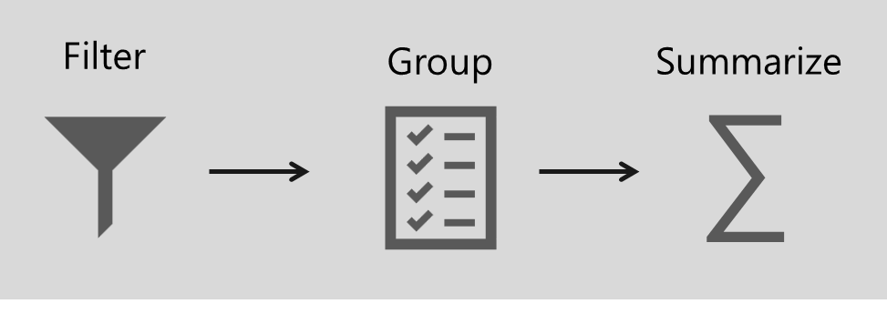
Define analytic query
An Analytic query retrieves data from a data model
It has three distinct phases:
Filter
Group
Summarize
BETA version
Notes:
An analytic query is a query that produces a result from a data model.
Each Power BI visual, in the background, submits an analytic query to Power BI to query the model.
The analytic query is written as a Data Analysis Expressions (DAX) query statement.
However, you don't need to write a native DAX statement; you only need to configure report visuals by mapping dataset fields.

Slide 26
Define analytic query
1: Filter phase
The Filter phase targets data of relevance
It can be applied to:
Report
Page
Visual
Also applied using row-level security (RLS)
Visuals can inherit filters, or they can be applied directly
BETA version
Notes:
Filtering, or slicing, targets the data of relevance.
In Power BI reports, filters can be applied to three different scopes:
report,
page,
or visual.
Filtering is also applied in the background when row-level security (RLS) is enforced.
Each report visual can inherit filters or have filters directly applied to it.

Slide 27
Define analytic query
2: Group phase
The Group phase divides query results into groups
It often groups by entity (column) in dimension table
Common examples of grouping:
Year, Month, or Day
Product category
Country or region
BETA version
Notes:
Grouping, or dicing, divides query results into groups.

Slide 28
Define analytic query
3: Summarize
The Summarize phase produces a single value
Typically, numeric columns are summarized
Common examples of summarizing:
Sum
Count
Average
Min and Max
BETA version
Notes:
Summarizing produces a single value result.
Typically, numeric columns are summarized by using summarization methods (sum, count, and many others).
These methods are simple summarizations.
More complex summarizations, like a percent of grand total, can be achieved by defining measures that are written in DAX
Not all analytic queries need to filter, group, and summarize:
Commonly, report visuals are filtered, perhaps by a time period or geographic location.
Grouping is optional. For example, a card visual, which is used to display a single value, isn't concerned with grouping.
Typically, report visuals summarize. One notable exception, however, is the slicer visual, which isn't concerned with summarization.

Slide 29

Configure report visuals
Fields
Fields is a collective term for columns, hierarchy levels, and measures
They can be used in the following phases of an analytic query
Field type | Filter | Group | Summarize
Column
Hierarchy level
Measure
Columns can be used to Filter, Group, or Summarize
Hierarchy levels can be used to Filter or Group
Measures can be used to Filter or Summarize
BETA version
Notes:
Use columns to filter, group, and summarize column values.
Summarizing numeric columns is common, and it can be done by using sum, count, distinct count, minimum, maximum, average, median, standard deviation, and variance.
You can also summarize text columns by using first (alphabetic order), last, count, and distinct count.
Additionally, you can summarize date columns by using earliest, latest, count, and distinct count.
At design time, the data modeler can set the column default summarization property.
This property can be set to any of the supported summarization types or to Do not summarize.
The latter option means that the column, by default, is only to be used to group.
If your data model has a numeric column that stores year values, it would be appropriate to set its default summarization to Do not summarize because the column will likely be used only for grouping or filtering, and that numeric summarization of years, like an average, doesn't produce a meaningful result.

Slide 30
Configure report visuals
Hierarchy levels
Hierarchy levels are based on columns
They can be used to filter and group—but not to summarize
BETA version
Notes:
While hierarchy levels are based on columns, they can be used to filter and group but not to summarize.
Report authors can summarize the column that the hierarchy level is based on, provided that it's visible in the Fields pane.

Slide 31
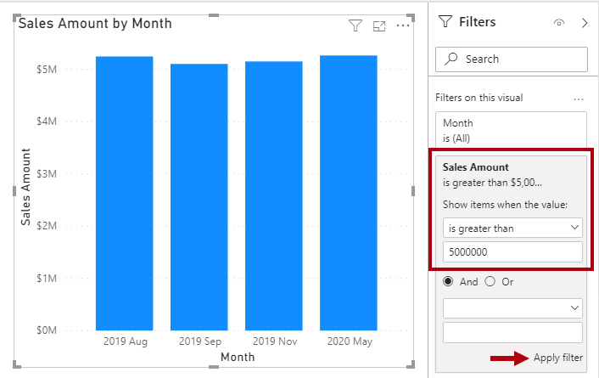
Configure report visuals
Measures
Measures are designed to summarize
They can be used to filter
However, they filter groups by the measure—for example, show only months where the sales amount (summarization) is greater than $5M
They cannot be used to group data
BETA version
Notes:
Measures are designed to summarize model data; they can't be used to group data.
However, measures can be used to filter data in one special case: to use a measure to filter a visual when the visual displays the measure and the filter is a visual-level filter (so, not a report or page-level filter).
When used in this way, a measure filter is applied after the analytic query has summarized data.
This process is done to eliminate groups where the measure filter condition is not true. (For those who are familiar with SQL syntax, a measure that used to filter a visual is like the HAVING clause in a SELECT statement.)
The following figure shows the stacked column visual adjusted to display groups (months) when sales amounts exceed $5 million.
This adjustment is done in the Filters pane by applying a filter to the Sales Amount field: Configure the filter to show items when the value is greater than 5000000.
Remember to select Apply filter, which is located in the lower-right corner of the card.
Notice that only four groups (months) have sales amounts exceeding $5 million.

Slide 32
Resources
Learn: Describe Power BI Desktop models
https://docs.microsoft.com/learn/modules/dax-power-bi-models/
Docs: DAX overview
https://docs.microsoft.com/dax/dax-overview
Docs: Understand star schema and the importance for Power BI
https://docs.microsoft.com/power-bi/guidance/star-schema

Slide 33
Power BI DAX in a Day
Module 02
Write DAX Formulas

Slide 34
Module outline
02: Write DAX Formulas
Describe DAX calculation types
Write DAX formulas
Describe DAX data types
Work with DAX functions
Use DAX operators
Notes:
This module covers the basics on how to write DAX formulas.

Slide 35
Describe DAX calculation types
DAX can be used to create three types of calculations:
Calculated table
Calculated column
Measure
DAX can also be used to define row-level security (RLS) rules
RLS is not in scope for this course
Notes:
By using Data Analysis Expressions (DAX), you can add three types of calculations to your data model:
NOTE:
DAX can also be used to define row-level security (RLS) rules, which are expressions that enforce filters over model tables.
However, rules aren't considered to be model calculations so they're out of scope for this module. For more information, see Row-level security (RLS) with Power BI .

Slide 36
Describe DAX calculation types
Calculated table
A Calculated table adds a new table to the model
Examples:
Date tables
Role-playing dimensions
What-if analysis
Each calculated table will increase the storage size of the model
Notes:
You can write a DAX formula to add a calculated table to your model.
The formula can
duplicate or transform existing model data, or
create a series of data, to produce a new table.
Calculated table data is always imported into your model, so it increases the model storage size and can prolong data refresh durations.
A calculated table can't connect to external data; you need to use Power Query to accomplish that task.

Slide 37
Describe DAX calculation types
Calculated table » Date table
A Date table is required to work with Time Intelligence functions
It can be created using the CALENDAR or CALENDARAUTO functions
Notes:
Date tables are required to apply special time filters known as time intelligence.
A family of DAX functions, known as time-intelligence functions, only work correctly when a date table is set up.
When your source data doesn't include a date table, you can create one as calculated tables by using the CALENDAR or CALENDARAUTO DAX functions.

Slide 38
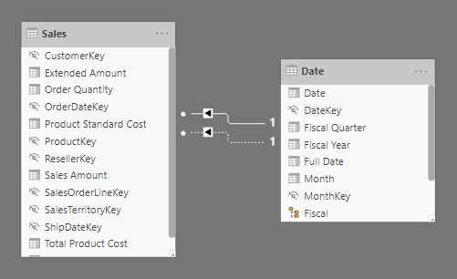
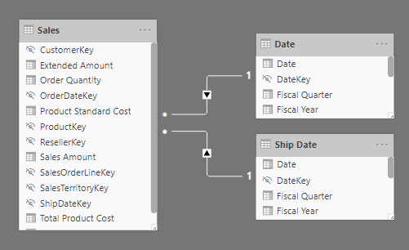
Describe DAX calculation types
Calculated table » Role-playing dimensions
Inactive relationships
Duplicate tables with active relationships
Notes:
When two model tables have multiple relationships, it could be because your model has a role-playing dimension.
For example, if you have a table named Sales that includes two date columns,
OrderDateKey and
ShipDateKey,
both columns are related to the Date column in the Date table.
In this case, the Date table is described as a role-playing dimension because it could play the role of order date or ship date.
Microsoft Power BI models only allow one active relationship between tables, which in the model diagram is indicated as a solid line.
The active relationship is used by default to propagate filters, which in this case would be from the Date table to the OrderDateKey column in the Sales table.
Any remaining relationships between the two tables are inactive.
In a model diagram, the relationships are represented as dashed lines. Inactive relationships are only used when they're expressly requested in a calculated formula by using the USERELATIONSHIP DAX function.
Perhaps a better model design could have two date tables, each with an active relationship to the Sales table.
Thus, report users can filter by order date or ship date, or both at the same time. A calculated table can duplicate the Date table data to create the Ship Date table.

Slide 39
Describe DAX calculation types
Calculated table » What-if analysis
Power BI Desktop supports creating What-if Parameters
It automates the creation of a calculated table with a generated series of rows, and a measure to retrieve the currently selected value
Commonly used in what-if analysis
Typically, these tables remain disconnected (not related to other tables)
Examples: Currency conversion, forecasting scenarios
Notes:
Power BI Desktop supports a feature called What-if parameters .
When you create a what-if parameter, a calculated table is automatically added to your model.
What-if parameters allow report users to select or filter by values that are stored in the calculated table.
Measure formulas can use selected value(s) in a meaningful way.
For example, a what-if parameter could allow the report user to select a hypothetical currency exchange rate, and a measure could divide revenue values (in a local currency) by the selected rate.
Notably, what-if calculated tables aren't related to other model tables because they're not used to propagate filters. For this reason, they're sometimes called disconnected tables.

Slide 40
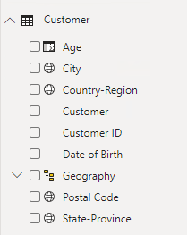
Describe DAX calculation types
Calculated column
A Calculated column adds a new column to a table
A formula is evaluated for each row in table
The formula must return a single value
It is only evaluated when model is refreshed*
It increase storage size of the model*
*Except when added to a DirectQuery table
Notes:
You can write a DAX formula to add a calculated column to any table in your model.
The formula is evaluated for each table row and it returns a single value.
When added to an Import storage mode table, the formula is evaluated when the data model is refreshed and it increases the storage size of your model.
When added to a DirectQuery storage mode table, the formula is evaluated by the underlying source database when the table is queried.
In the Fields pane, calculated columns are enhanced with a special icon.
The following example shows a single calculated column in the Customer table called Age.

Slide 41
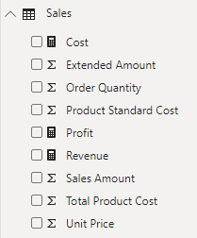
Describe DAX calculation types
Measures
A Measure summarizes model data
The formula must return a single value
It is evaluated at query-time
Results are never stored in the model
Notes:
You can write a DAX formula to add a measure to any table in your model.
The formula is concerned with achieving summarization over model data.
Similar to a calculated column, the formula must return a single value.
Unlike calculated columns, which are evaluated at data refresh time, measures are evaluated at query time and their results are never stored in the model.
In the Fields pane, measures are shown with the calculator icon. The following example shows three measures in the Sales table: Cost, Profit, and Revenue.

Slide 42
Write DAX formulas
Each model calculation type is defined by its name, followed by the equals symbol (=), which is then followed by a DAX formula
<calculation name> = <DAX formula>
Ship Date = 'Date'
Notes:
Each model calculation type, calculated table, calculated column, or measure is defined by its name, followed by the equals symbol (=), which is then followed by a DAX formula.
Use the following template to create a model calculation:

Slide 43
Write DAX formulas
A DAX formula consists of expressions that return a result
The result is either a table object or a scalar value
Topics:
DAX functions
DAX operators
References to model objects
Constant values
DAX variables
Whitespace
Notes:
A DAX formula consists of expressions that return a result.
The result is either a table object or a scalar value.
Calculated table formulas must return a table object;
calculated column and measure formulas must return a scalar or single value.
TIP
When entering DAX formulas in Power BI Desktop, you have the benefit of IntelliSense.
IntelliSense is a code-completion aid that lists functions and model resources.
When you select a DAX function, it also provides you with a definition and description.
We recommend that you use IntelliSense to help you quickly build accurate formulas.

Slide 44
Write DAX formulas
DAX functions
DAX is a functional language
Functions can use parameters
Functions can be nested
Most functions return an object (scalar value, column, or table)
Many common functions will be introduced in this course
Notes:
Similar to Microsoft Excel, DAX is a functional language;
formulas rely on DAX functions to accomplish specific goals. Typically, functions have arguments that allow passing in variables.
Formulas can use many function calls and will often nest functions within other functions.
In a formula, function names must be followed by parentheses. Within the parentheses, variables are passed in.
[Note]
Some functions don't take arguments, or arguments might be optional.
Working with DAX functions is described later in this module.

Slide 45
Write DAX formulas
DAX operators
Formulas also rely on DAX operators, which can perform arithmetic calculations, compare values, work with strings, or test conditions
Operators can:
Perform arithmetic calculations
Compare values
Work with strings
Test conditions
DAX operators are described later in this module
Notes:
Formulas also rely on DAX operators, which can perform arithmetic calculations, compare values, work with strings, or test conditions.
DAX operators are described in more detail later in this module.

Slide 46
Write DAX formulas
Reference model objects
There are only three types of model objects that are referenced by DAX formulas:
Tables
Columns
Measures
It is not possible to reference a hierarchy level
Instead, use the column that the level is based on
Notes:
Formulas can only refer to three types of model objects: tables, columns, or measures.
A formula can't refer to a hierarchy or a hierarchy level. (Recall that a hierarchy level is based on a column, so your formula can refer to a hierarchy level's column.)

Slide 47
Write DAX formulas
Reference model objects » Table reference
Table references use the table name
If the table is a reserved word, it must be enclosed in single quotes
Arrival Airport = Airport
Ship Date = 'Date'
Notes:
When you are referencing a table in a formula, officially, the table name is enclosed within single quotation marks.
In the following calculated table definition, notice that the Date table is enclosed within single quotation marks.
However, single quotation marks can be omitted when both of the following conditions are true:
The table name does not include embedded spaces.
The table name is not a reserved word that is used by DAX. All DAX function names and operators are reserved words.
Date is a DAX function name, which explains why, when you are referencing a table named Date, that it must be enclosed within single quotation marks.
In the following calculated table definition [Airport], it's possible to omit the square brackets when referencing the Airport table:

Slide 48
Write DAX formulas
Reference model objects » Column reference
Column references always enclose the column name in square brackets
To improve readability and to disambiguate, precede the column name with its table name
Revenue = SUM([Sales Amount])
Revenue = SUM(Sales[Sales Amount])
Notes:
When you are referencing a column in a formula, the column name must be enclosed within square brackets.
Optionally, it can be preceded by its table name. For example, the following measure definition refers to the Sales Amount column.
[TIP]
To improve the readability of your formulas, we recommend that you always precede a column reference with its table name.
This tip helps quickly clarify if an object reference refers to a measure or column
Because column names are unique within a table but not necessarily unique within the model, you can disambiguate the column reference by preceding it with its table name.
This disambiguated column is known as a fully qualified column. Some DAX functions require passing in fully qualified columns

Slide 49
Write DAX formulas
Reference model objects » Measure reference
Measure references always enclose the measure name in square brackets
Profit = [Revenue] - [Cost]
Notes:
When you are referencing a measure in a formula, like column name references, the measure name must be enclosed within square brackets.
For example, the following measure definition refers to the Revenue and Cost measures.
If you are a DAX beginner, the fact that column and measure references are always enclosed within square brackets can cause confusion when you are trying to read a formula.
However, when you're proficient with DAX fundamentals, you'll be able to determine which type of object it is because, in DAX formulas, columns, and measures are used in different ways.
[TIP]
It's possible to precede a measure reference with its table name.
However, measures are a model-level object.
While they're assigned to a home table, it's only a cosmetic relationship to logically organize measures in the Fields pane.
Therefore, while we recommend that you always precede a column reference with its table name, the inverse is true for measures:
We recommend that you never precede a measure reference with its table name.

Slide 50
Write DAX formulas
DAX variables
Variables can be defined in an expression to make writing DAX easier
Main benefits:
Improves readability of a formula
Improves performance when an expression is used multiple times
Allows testing portions of a complex formula, by returning only a variable for review
VAR <name> = <expression> [VAR <name2>…]
RETURN <expression>
Notes:
Formulas can declare DAX variables to store results.
How and when to use DAX variables is described later in this course

Slide 51
Write DAX formulas
DAX variables » Example
Revenue YoY % = VAR RevenuePriorYear = CALCULATE( [Revenue], SAMEPERIODLASTYEAR('Date'[Date]) ) RETURN DIVIDE( [Revenue] - RevenuePriorYear, RevenuePriorYear )
Notes:
The following example shows a formula that declares a variable.
The Revenue YoY % measure definition is rewritten to declare a variable that's assigned the value of the prior year's revenue.
Notice that the RETURN clause refers to the variable twice.
This improved measure definition formula will run in at least half the time because it doesn't need to evaluate the prior year's revenue twice.

Slide 52
Write DAX formulas
Whitespace
Whitespace refers to characters that format formulas in a way that is quick and simple to understand
Whitespace characters include:
Spaces
Tabs
Carriage returns
Notes:
Whitespace refers to characters that you can use to format your formulas in a way that's quick and simple to understand.
Whitespace characters include: [shown on slide]
Whitespace is optional and it doesn't modify your formula logic or negatively impact performance.

Slide 53
Write DAX formulas
Whitespace » Usage
Use spaces between operators
Use tabs to indent nested function calls
Use carriage returns to separate function arguments
Err on side of more whitespace
Notes:
Whitespace refers to characters that you can use to format your formulas in a way that's quick and simple to understand.
Whitespace characters include: [shown on slide]
Whitespace is optional and it doesn't modify your formula logic or negatively impact performance.
We strongly recommend that you adopt a format style and apply it consistently, and consider the following recommendations:
Use spaces between operators.
Use tabs to indent nested function calls.
Use carriage returns to separate function arguments, especially when it's too long to fit on a single line.
Formatting in this way makes it simpler to troubleshoot, especially when the formula is missing a parenthesis.
Err on the side of too much whitespace than too little.

Slide 54
Write DAX formulas
Whitespace » Example
Revenue YoY % = DIVIDE([Revenue] - CALCULATE([Revenue], SAMEPERIODLASTYEAR ('Date'[Date])), CALCULATE ([Revenue], SAMEPERIODLASTYEAR ('Date'[Date])))
Revenue YoY % = DIVIDE( [Revenue] - CALCULATE( [Revenue], SAMEPERIODLASTYEAR ('Date'[Date]) ), CALCULATE ( [Revenue], SAMEPERIODLASTYEAR ('Date'[Date]) ) )
Notes:
Consider the top measure definition that's written in a single line and that includes five DAX function calls:
[CLICK] The following example is the same measure definition but now formatted, which helps make it easier to read and understand:
Try formatting the measure on your own. Open the Adventure Works DW 2020 M02.pbix Power BI Desktop file and then, in the Fields pane, expand the Sales table and select the Revenue YoY % measure.
Use tab and carriage return characters to produce the same result as the previous example.
When you add a carriage return, remember to press the Shift+Enter shortcut keys.
This measure definition can still be improved for readability and performance, which will be explained later in this module
Tip:
An excellent formatting tool from another source that can help you format your calculations is DAX Formatter .
The tool allows you to paste in your calculation and format it.
Then, you can copy the formatted calculation to your clipboard and paste it back into Power BI Desktop.

Slide 55
Describe DAX data types
Columns have a set data type
Column types are set in Power Query or for calculated columns, they are inferred from the DAX formula
Measure data types are inferred from the DAX formula
Notes:
Data model columns have a set data type, which ensures that all column values conform to that data type.
Column data types are defined in Power Query, or in the case of calculated columns, it's inferred from the formula.
Measure data types, similar to calculated column data types, are inferred from the formula.
Model data types aren't the same as DAX data types, though a direct relationship exists between them.
The following table lists the model data types and DAX data types. Notice the supported range of values for each data type.

Slide 56
Describe DAX data types
Model data type | DAX data type | Description
Whole number | 64-bit integer | -2⁶³ through 2⁶³-1
Decimal number | 64-bit real | 8 bytes per value (64 bits!!) – Like (SQL) Float
Boolean | Boolean | TRUE or FALSE
Text | String | Unicode character string
Date | Date/time
Currency | Currency | -9.22 x 10¹⁴ to 9.22 x 10¹⁴ Limited to four decimal digits of fixed precision
N/A | BLANK | Sometimes equivalent to SQL
Notes:
Model data types aren't the same as DAX data types, though a direct relationship exists between them.
The following table lists the model data types and DAX data types. Notice the supported range of values for each data type.

Slide 57
Describe DAX data types
BLANK
DAX uses BLANK for both database NULL and for blank cells in Excel
BLANK doesn't mean zero
Perhaps it is simpler to think of it as the "absence of a value“
Two DAX functions are related to the BLANK data type:
BLANK - Returns BLANK
ISBLANK - Tests whether an expression evaluates as BLANK
Notes:
The BLANK data type deserves a special mention.
DAX uses BLANK for both database NULL and for blank cells in Excel.
BLANK doesn't mean zero.
Perhaps it might be simpler to think of it as the "absence of a value".
Two DAX functions are related to the BLANK data type: the BLANK DAX function returns BLANK, while the ISBLANK DAX function tests whether an expression evaluates to BLANK.

Slide 58
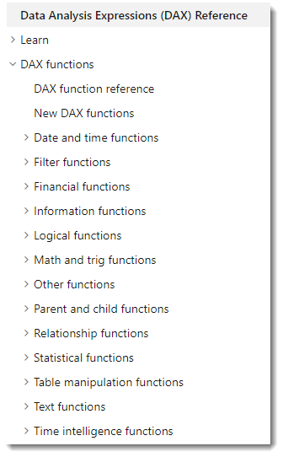
Work with DAX functions
The DAX function library consists of hundreds of functions, each designed to accomplish a specific goal
Many are similar to Excel functions
Some are specific to data modeling:
Relationship navigation
Filter context modification
Iterator
Time Intelligence
Path
Notes:
The DAX function library consists of hundreds of functions, each designed to accomplish a specific goal.
Because DAX originated with the Power Pivot add-in for Microsoft Excel 2010, over 80 functions are available that can also be found in Excel.
It was a deliberate design strategy by Microsoft to ensure that Excel users can quickly become productive with DAX.
[TIP]
To search for documentation that is related to a DAX function, in a web search, enter the keyword DAX followed by the function name.

Slide 59
Work with DAX functions
Excel-like functions
Summarization functions
SUM, COUNT, AVERAGE, MIN, MAX ….
Mathematic functions
ABS, ROUND, SQRT, LEN, LEFT, RIGHT, UPPER, DATE, YEAR, MONTH, NOW, ISNUMBER, TRUE, FALSE, AND, OR, NOT, ISERROR
Conditional logic
IF ( <logical_test>, <value_if_true> [, <value_if_false> ] )
Notes:
The following sections consider several useful functions that you might already be familiar with because they exist in Excel.
The IF DAX function tests whether a condition that is provided as the first argument is met. It returns one value if the condition is TRUE and returns the other value if the condition is FALSE. The function's syntax is:
[Tip]
A function argument is optional when documentation shows it enclosed within square brackets.
Many Excel summarization functions are available, including SUM, COUNT, AVERAGE, MIN, MAX, and many others.
The only difference is that in DAX, you would pass in a column reference, whereas in Excel, you would pass in a range of cells.
Many Excel mathematic, text, date and time, information, and logical functions are available as well.
For example, a small sample of Excel functions that are available in DAX include ABS, ROUND, SQRT, LEN, LEFT, RIGHT, UPPER, DATE, YEAR, MONTH, NOW, ISNUMBER, TRUE, FALSE, AND, OR, NOT, and IFERROR.

Slide 60
Work with DAX functions
Not found in Excel
DISTINCTCOUNT
DIVIDE
DIVIDE ( <numerator>, <denominator> [, <alternate_result>] )
Notes:
You can use the DISTINCTCOUNT DAX function to count the number of distinct values in a column.
This function is especially powerful in an analytics solution.
Consider that the count of customers is different from the count of distinct customers.
The latter doesn't count repeat customers, so the difference is "How many customers" compared with "How many different customers.“
DIVIDE
You can use the DIVIDE DAX function to achieve division.
You must pass in numerator and denominator expressions.
Optionally, you can pass in a value that represents an alternate result. The DIVIDE function's syntax is:
The DIVIDE function was designed to automatically handle division by zero cases.
If an alternate result isn't passed in, and the denominator is zero or BLANK, the function returns BLANK.
When an alternate result is passed in, it's returned instead of BLANK.
This function is convenient because it saves your expression from having to first test the denominator value.
The function is also better optimized for testing the denominator value than the IF function.
The performance gain is significant because checking for division by zero is expensive.
What's more, using the DIVIDE function results in a more concise and elegant expression.
We recommend that you use the DIVIDE function whenever the denominator is an expression that could return zero or BLANK.
In the case that the denominator is a constant value, we recommend that you use the divide operator (/), which is introduced later in this module.
In this case, the division is guaranteed to succeed, and your expression will perform better because it will avoid unnecessary testing.

Slide 61
Use DAX operators
Arithmetic operators
Operator | Description | Example
+ | Addition | 2 + 3 = 5
- | Subtraction | 5 - 3 = 2
* | Multiplication | 2 * 3 = 6
/ | Division | 6 / 3 = 2
^ | Exponentiation | 2 ^ 3 = 8
Notes:
Remember, when you are dividing two expressions, and when the denominator could return zero or BLANK, it's more efficient and safer to use the DIVIDE DAX function.

Slide 62
Use DAX operators
Comparison operators
Operator | Description | Example | Result
= | Equal To | 2 = 3 | FALSE
== | Strict equal to | [Revenue] == 0 | *
> | Greater than | 2 > 3 | FALSE
< | Less than | 2 < 3 | TRUE
>= | Greater than or equal to | 2 >= 3 | FALSE
<= | Less than or equal to | 2 <= 3 | TRUE
<> | Not equal to | 2 <> 3 | TRUE
Notes:
All comparison operators, except strict equal to (==), treat BLANK as equal to the number zero, an empty string (""), the date December 30, 1899, or FALSE.
It means that the expression [Revenue] = 0 will be TRUE when the value of [Revenue] is either zero or BLANK. In contrast, [Revenue] == 0 is TRUE only when the value of [Revenue] is zero.

Slide 63
Use DAX operators
Text concatenation
Use the ampersand (&) character to concatenate text values
DAX functions CONCATENATEX and COMBINEVALUES are also options for text concatenation
Model Color = Product[Model] & "-" & Product[Color]
Notes:
Uses & (and not + like other languages).
DAX functions CONCATENATEX and COMBINEVALUES are also options for text concatenation

Slide 64
Use DAX operators
Logical operators
Operator | Description | Example | Result
&& | Logical AND | TRUE && FALSE | FALSE
|| | Logical OR | TRUE || FALSE | TRUE
IN | Multiline OR | “A” IN {“A”, “B” “C”} | TRUE
NOT | Inverts state | NOT FALSE | TRUE
Customer[Country-Region] IN { "Australia", "New Zealand" }
Notes:
An example that uses the IN logical operator.

Slide 65
Use DAX operators
Operator precedence
Operator | Description
^ | Exponentiation
- | Sign (as in -1)
* and / | Multiplication and Division
NOT | NOT
+ and - | Addition and subtraction
& | Text concatenation
=, ==, <, >, <=, >=, <> | Comparison
Notes:
When your DAX formula includes multiple operators, DAX uses rules to determine the evaluation order, which is known as an operator precedence.
Operations are ordered according to the following table.
When the operators have equal precedence value, they are ordered from left to right.
In general, operator precedence is the same as what's found in Excel.
If you need to override the evaluation order, then group operations within parentheses.
For example, consider the following calculated column definition:

Slide 66
Use DAX operators
Operator precedence » Examples
Operation | Result
2 + 3 * 4 | 14
(2 + 3) * 4 | 20
Notes:
Top line
3 * 4 = 12 + 2 = 14
Bottom line
2 + 3 = 5 * 4 = 20
[TIP]
Remembering operator precedence rules can be challenging, especially for DAX beginners.
Consequently, we recommend that you test your formulas thoroughly.
When the formulas don't produce the correct result due to an incorrect evaluation order, you can experiment by adding parentheses to adjust the evaluation order.
You can also add parentheses to improve the readability of your form

Slide 67
Use DAX operators
Implicit conversion
Usually, DAX automatically identifies the data types of referenced model objects and performs implicit conversions where necessary to complete the specified operation
Operator | Result | Conversion
TRUE && 1 | TRUE | 1 to TRUE
TRUE && 0 | FALSE | 0 to FALSE
“A” & 1 | “A1” | 1 to text
DATE(2020,1,1) + “2” | 3 Jan 2020 | “2” to integer
“6” / “2” | 3 | “6” and “2” to integer
Notes:
When writing a DAX formula that uses operators to combine different data types, you don't need to explicitly convert types.
Usually, DAX automatically identifies the data types of referenced model objects and performs implicit conversions where necessary to complete the specified operation.
However, some limitations might exist on the values that can be successfully converted.
If a value or a column has a data type that's incompatible with the current operation, DAX returns an error.
For example, the attempt to multiply a date value will create an error because it isn't logical.
The BLANK formula is handled differently, depending on the operator that is used.
It's handled like how Excel treats BLANK, but differently to how databases (SQL) treat NULL.
BLANK is treated as zero when acted on by arithmetic operators and as an empty string when concatenated to a string.

Slide 68
Lab 2
Write DAX formulas for Power BI
Notes:
Students will use the lab document to complete the lab.

Slide 69
Power BI DAX in a Day
Module 03
Define Calculated Tables and Columns

Slide 70
Module outline
03: Define Calculated Tables and Columns
Create calculated tables
Create calculated columns
Describe row context
Choose technique to add a column
Notes:
This module describes creating calculated tables and calculated columns.

Slide 71
Create calculated tables
A Calculated table is created using a DAX formula
The formula can duplicate or transform existing table
It cannot connect to external data
The formula must return a table object
It will increase the storage size of the model
It can increase the data refresh time
Notes:
You can write a Data Analysis Expressions (DAX) formula to add a calculated table to your model.
The formula can duplicate or transform existing model data to produce a new table.
Note
A calculated table can't connect to external data; you must use Power Query to accomplish that task.
A calculated table formula must return a table object. The simplest formula can duplicate an existing model table.
Calculated tables have a cost: They increase the model storage size and they can prolong the data refresh time.
The reason is because calculated tables recalculate when they have formula dependencies to refreshed tables.

Slide 72
Create calculated columns
A Calculated column is added to a table using a DAX formula
It can be added to any table in your model
The formula must return a scalar—or single—value
It will increase the storage size of the model
It can increase the data refresh time
Notes:
You can write a DAX formula to add a calculated column to any table in your model.
A calculated column formula must return a scalar or single value.
Calculated columns in import models have a cost:
They increase the model storage size and they can prolong the data refresh time.
The reason is because calculated columns recalculate when they have formula dependencies to refreshed tables.

Slide 73
Describe row context
The calculated column formula is evaluated for each table row
Evaluation is within row context, which means current row
Due Fiscal Year =
"FY"
& YEAR('Due Date'[Due Date])
+ IF(
MONTH('Due Date'[Due Date]) <= 6,
1
)
Notes:
Row context can be thought of as "the current row". If you create a formula in a calculated column, the row context for that formula includes the values from all columns in the current row. If the table is related to another table, the content also includes all the values from the other table that are related to the current row.
Later in this course you will introduce filter context.

Slide 74
Choose technique to add a column
There are three techniques to add a column to a table:
Add a column in data source
Add a computed column (using M) to a query in Power Query
Add a calculated column (using DAX) to a model table
Regardless of the technique used, it results in the same outcome
Report designers or users cannot determine the origin of a column
Notes:
Typically, they're not concerned with how the column was created but rather that it delivers the right data.
When multiple ways are available to add a column, you can consider using the approach that best fits your skills and that's supported by the language (M or DAX).
However, the preference is to add computed columns in Power Query, whenever possible, because they load to the model in a more compact and optimal way.
When you need to add a column to a calculated table, make sure that you create a calculated column.
Otherwise, we recommend that you only use a calculated column when the calculated column formula:
Depends on summarized model data.
Needs to use specialized modeling functions that are only available in DAX, such as the RELATED or RELATEDTABLE functions.
Specialized functions can also include the DAX parent and child hierarchies , which are designed to naturalize a recursive relationship into columns,
for example, in an employee table where each row stores a reference to the row of the manager (who is also an employee).

Slide 75
Resources
Learn: Add calculated tables and columns to Power BI Desktop models
https://docs.microsoft.com/learn/modules/dax-power-bi-add-calculated-tables/
Docs: DAX overview (Row context)
https://docs.microsoft.com/dax/dax-overview#row-context

Slide 76
Power BI DAX in a Day
Module 04
Define Measures

Slide 77
Module outline
04: Define Measures
Describe measure types
Create Quick Measures
Describe differences between calculated column and measure
Notes:
This module describes measures and how to create them. It also describes the differences between calculated columns and measures because it’s a common source of confusion for beginners.

Slide 78
Describe measure types
Measures produce summarizations of model data
There are two types of measures:
Implicit measure
Explicit measure
Notes:
Implicit and explicit are two types of measures.
Implicit measures are automatic behaviors that allow visuals to summarize model column data.
Explicit measures, also known simply as measures, are calculations that you can add to your model.
The following sections focus on how you can use implicit measures.
Implicit and explicit are two types of measures.
Implicit measures are automatic behaviors that allow visuals to summarize model column data.
Explicit measures, also known simply as measures, are calculations that you can add to your model.
The following sections focus on how you can use implicit measures.

Slide 79
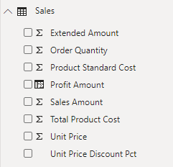
Describe measure types
Implicit measure
An Implicit measure is a model column that is summarized
Implicit measures:
Appear with the sigma symbol (∑) in the Fields pane
Are always numeric columns
Will summarize values when added to a visual
Notes:
In the Fields pane, a column that's shown with the sigma symbol (∑) indicates two facts:
It's a numeric column.
It will summarize column values when it is used in a visual (when added to a field well that supports summarization).
In the following image, notice that the Sales table includes only fields that can be summarized, including the Profit Amount calculated column.
As a data modeler, you can control if and how the column summarizes by setting the Summarization property to Don't summarize or to a specific aggregation function.
When you set the Summarization property to Don't summarize, the sigma symbol will no longer show next to the column in the Fields pane.
Calendar Year is often a numeric column to disable summarization

Slide 80
Describe measure types
Implicit measure (continued)
Benefits:
Simple to use
Easy to learn
Less work as a data modeler
Limitations:
Easy to choose wrong default
Limited scenarios
Not visible to MDX
Notes:
Several benefits are associated with implicit measures. Implicit measures are simple concepts to learn and use, and they provide flexibility in the way that report authors visualize model data. Additionally, they mean less work for you as a data modeler because you don't have to create explicit calculation.
Implicit measures do have limitations. Despite setting an appropriate summarization method, report authors could choose to aggregate a column in unsuitable ways. For example, in the matrix visual, you could modify the aggregate function of Unit Price to Sum. (sum the individual unit price of products, not reflect Qty Sold)
The report visual obeys your configuration, but it has now produced a Sum of Unit Price column, which contains misleading data.
Limited Scenarios
The most significant limitation of implicit measures is that they only work for simple scenarios, meaning that they can only summarize column values that use a specific aggregation function.
Therefore, in situations when you need to calculate the ratio of each month's sales amount over the yearly sales amount, you'll need to produce an explicit measure by writing a Data Analysis Expressions (DAX) formula to achieve that more sophisticated requirement.
MDX
Implicit measures don't work when the model is queried by using Multidimensional Expressions (MDX).
This language expects explicit measures and can't summarize column data.
It's used when a Power BI dataset is queried by using Analyze in Excel or when a Power BI paginated report uses an MDX query that is generated by a graphical query designer.

Slide 81
Describe measure types
Explicit measure
An Explicit measure is a measure defined using DAX
Explicit measures:
Define a formula that returns a scalar—or single—value
Do not store values in the model
Cannot reference tables or columns directly
Notes:
https://docs.microsoft.com/en-us/learn/modules/dax-power-bi-add-measures/2-simple-measures
In the next example, you will add a measure to the Sales table. In the Fields pane, select the Sales table. To create a measure, in the Table Tools contextual ribbon, from inside the Calculations group, select New measure.
The measure definition adds the Revenue measure to the Sales table. It uses the SUM DAX function to sum the values of the Sales Amount column.
On the Measure tools contextual ribbon, inside the Formatting group, set the decimal places to 2
Tip: Immediately after you create a measure, set the formatting options to ensure well-presented and consistent values in all report visuals.
Now, add the Revenue measure to the matrix visual. Notice that it produces the same result as the Sales Amount implicit measure.
In the matrix visual, remove Sales Amount and Sum of Unit Price.
Next, you will create more measures. Create the Cost measure by using the following measure definition, and then set the format with two decimal places.
Create the Profit measure, and then set the format with two decimal places.
Notice that the Profit Amount column is a calculated column. This topic will be discussed later in this module.
Next, create the Quantity measure and format it as a whole number with the thousands separator
Create three unit price measures and then set the format of each with two decimal places.
Notice the different DAX aggregation functions that are used: MIN , MAX , and AVERAGE .
Now, hide the Unit Price column, which results in report authors losing their ability to summarize the column except by using your measures.
[Tip]
Adding measures and hiding columns is how you, the data modeler, can limit summarization options.
Next, create the following two measures, which count the number of orders and order lines.
Format both measures with zero decimal places. The COUNT DAX function counts the number of non-BLANK values in a column, while the DISTINCTCOUNT DAX function counts the number of distinct values in a column.
Because an order can have one or more order lines, the Sales Order column will have duplicate values.
A distinct count of values in this column will correctly count the number of orders.
Alternatively, you can choose the better way to write the Order Line Count measure. Instead of counting values in a column, it's semantically clearer to use the COUNTROWS DAX function. Unlike the previously introduced aggregation functions, which aggregate column values, the COUNTROWS function counts the number of rows for a table.

Slide 82
Describe measure types
Explicit measure » Compound measure
A Compound measure is an explicit measure that refers to other explicit measures
Profit = [Revenue] - [Cost]
Notes:
When a measure references one or more measures, it's known as a compound measure.
For this example, you will modify the Profit measure by using the following measure definition.
Format the measure with two decimal places.
Next, add the Profit measure to the matrix visual.
Now that your model provides a way to summarize profit, you can delete the Profit Amount calculated column.
By removing this calculated column, you've optimized the data model.
It results in a decreased data model size and shorter data refreshes.
The Profit Amount calculated column wasn't required because the Profit measure can directly produce the required result.

Slide 83
Quick Measures
Power BI Desktop supports creating Quick Measures
Benefits:
Quick and easy
Common calculation templates are available
Automatically creates the DAX expression
No need to understand any DAX
Once created, they are like any other explicit measure
To modify the measure, simply edit the formula
Notes:
Microsoft Power BI Desktop includes a feature named Quick Measures .
This feature helps you to quickly perform common, powerful calculations by generating the DAX expression for you.
Many categories of calculations and ways to modify each calculation are available to fit your needs.
Moreover, you are able to see the DAX that's generated by the quick measure and use it to jumpstart or expand your DAX knowledge.

Slide 84
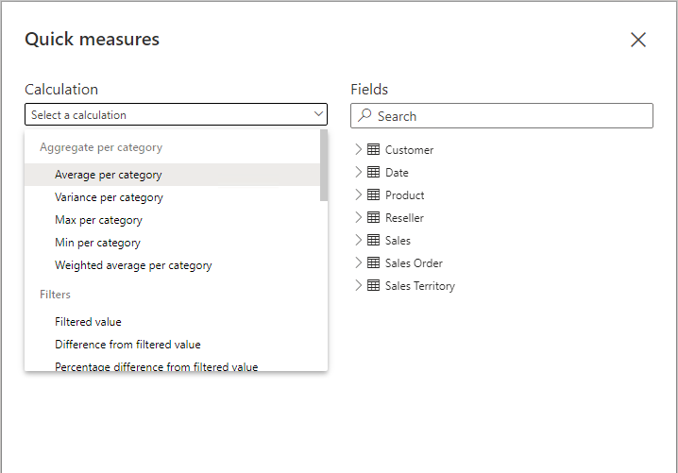
Quick Measures
Example
Notes:
This slide provides a screenshot of the Quick Measures window.

Slide 85
Calculated columns and measures
There are differences between calculated column and measure
 | Columns | Measures
Purpose | Extend table | Summarize model data
Evaluation | Row context at data refresh-time | Filter context at query-time
Storage | Stores value in each table row | Never stores value
Visual use | Filter, group, or summarize | Designed to summarize
Notes:
DAX beginners often experience a degree of confusion about calculated columns and measures.
The following section reviews the similarities and differences between both.
Regarding similarities between calculated columns and measures, both are:
Calculations that you can add to your data model.
Defined by using a DAX formula.
Referenced in DAX formulas by enclosing their names within square brackets.
The areas where calculated columns and measures differ include:
Purpose -
Calculated columns extend a table with a new column, while measures define how to summarize model data.
Evaluation -
Calculated columns are evaluated by using row context at data refresh time, while measures are evaluated by using filter context at query time.
Filter context is introduced in a later module; it's an important topic to understand and master so that you can achieve sophisticated summarizations.
Storage -
Calculated columns (in Import storage mode tables) store a value for each row in the table, but a measure never stores values in the model.
Visual use -
Calculated columns (like any column) can be used to filter, group, or summarize (as an implicit measure), whereas measures are designed to summarize.

